Slide 1


2018易贝乐百人名师天团养成计划（海选）

Slide 2

易贝乐百人名师天团养成计划
易贝乐少儿英语将从全国校区（直营+加盟）选拔出一批有潜力，有经验的优质教师，作为易贝乐百人名师天团成员，集团引入国内外资深专家，高质量培训营，重点培养，名师天团成员未来将是易贝乐学术引领者.

Slide 3

A Better You ,A Brighter Future
易贝乐百人名师天团养成计划

Slide 4

Who Are You?
个人照片
Name：
Age：
Area（A组 or B组）：
Campus：
Years of teaching:
Notes:
个人照片要求：照片内使用的照片高清

Slide 5
Daily teaching photo display
Please present your daily teaching photos here and note the section of the class.
请展示个人日常教学照片，并写明备注
要求照片清晰
文本框内容可删除
图片区域
可添加多张照片
Multiple photos can be added.
Notes:
请展示个人日常教学照片，并写明备注
要求照片清晰
文本框提示内容可删除

Slide 6
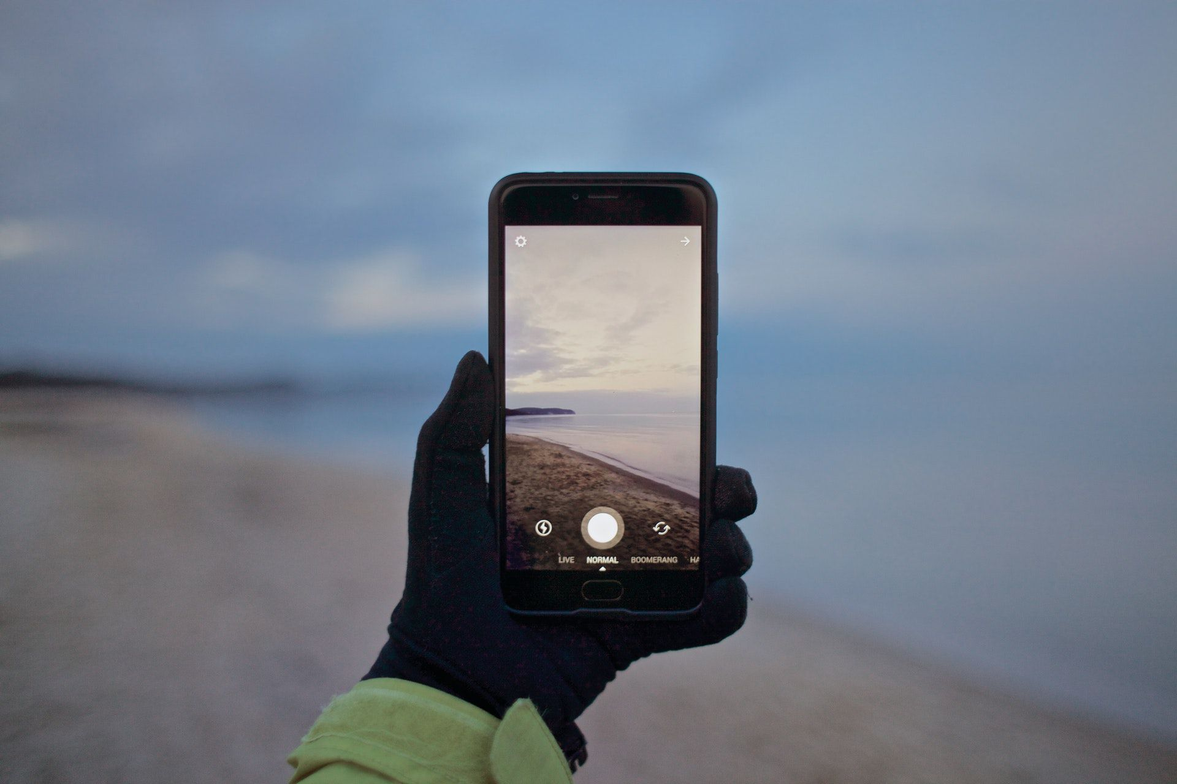
One of the most Memorable Stories in Education is ......
Notes:
温馨提示：从事教育以来和学生印象最深的一个故事

Slide 7
Your Title
Please write down your story here.……

Slide 8

Experience in Education
Notes:
从事多年教育教学工作，您有哪些心得体会

Slide 9
Your Title
Please write down your answers here.
……

Slide 10
Honors Show
Here, you can show your certificates and honors with pictures and titles.
Notes:
个人所获得的各类等级证书、荣誉展示

Slide 11
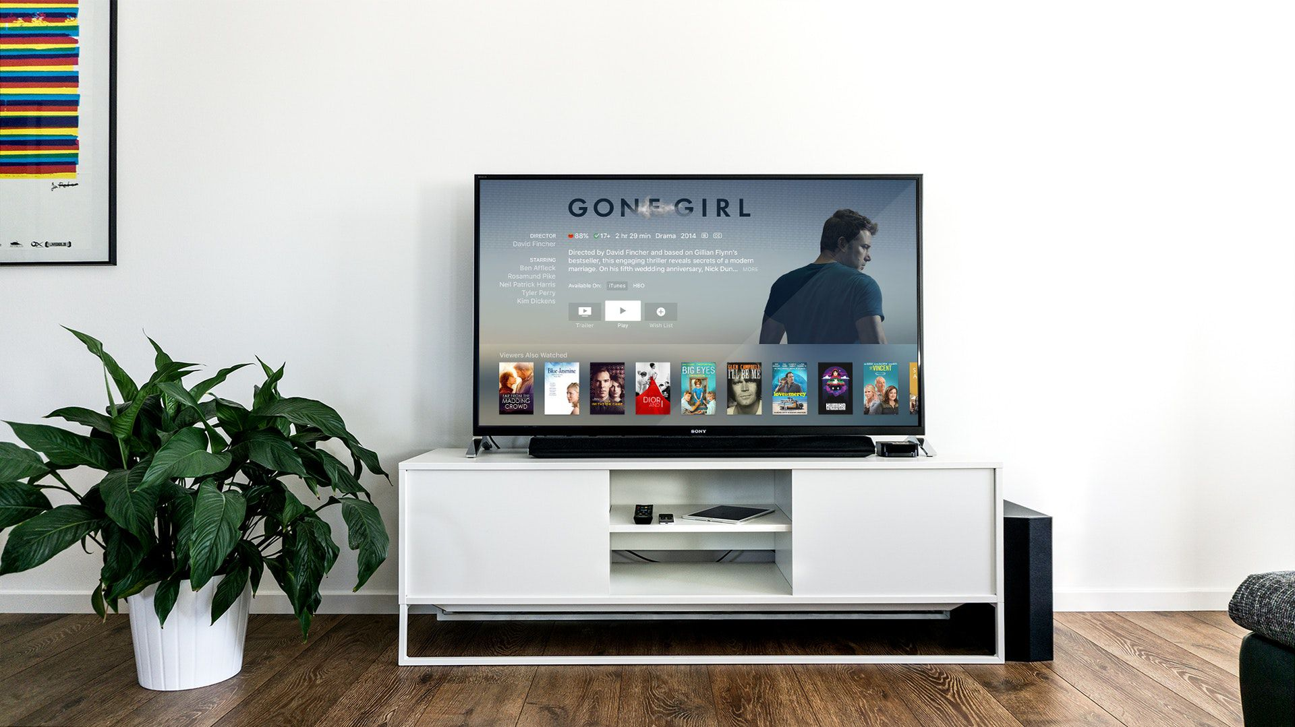
Video Display
Notes:
视频展示环节，本环节包含：1、个人5分钟教学视频展示+个人自我陈述

Slide 12
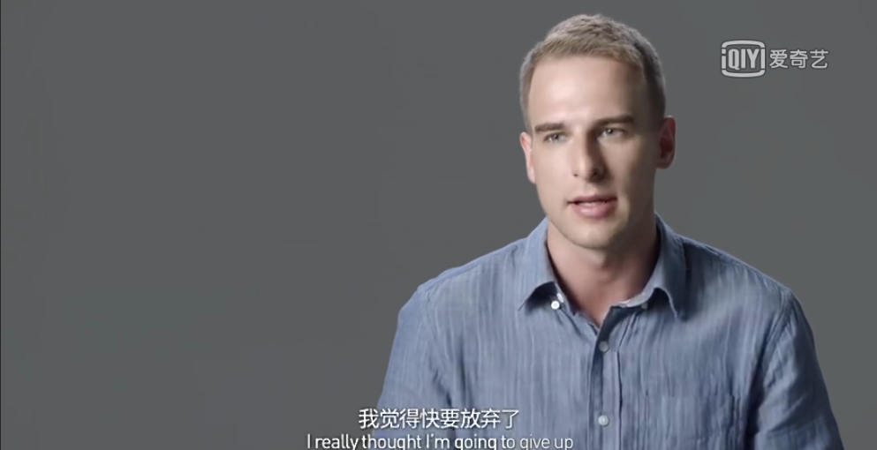
Video Display
Show Yourself
Maybe:
You were a white-collar worker...
You joined Eblocks Education at the time when you were feeling confused about lifelong plan.....
You don't like smiling...
You were dreaming to be a designer.……
视频示意
Notes:
视频要求：1、纯色背景+手机横屏拍摄+无杂音；2、穿带有新logo的工服录制 3、发型妆容整齐得体

Slide 13
No.1 show a video about your daily life
What's your name?
How many years have you been a teacher in E-Blocks?
What's your dream?
Why do you want to join E-blocks?
What did you gain as a teacher in E-blocks these years?
What did you gain as a teacher in E-blocks these years?
Your video must be within 5 mins.
Use Horizontal screen shooting in front of a white wall with no noise.
Notes:
视频要求：1、纯色背景+手机横屏拍摄+无杂音 ；2、穿带有新logo的工服录制 ；3、发型妆容整齐得体

Slide 14
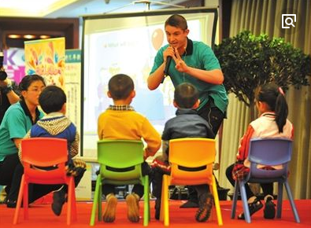
No.2 show a video about your teaching practice
Your video must be within 5 mins.
Use Horizontal screen shooting in front of a white wall with no noise.
Notes:
视频要求：1、纯色背景+手机横屏拍摄+无杂音 ；2、穿带有新logo的工服录制 ；3、发型妆容整齐得体

Slide 15

THANKS

